Slide 1
How to Decently Script
flag{thequickbrownfoxjumpedoverthelazydogandlearnedhowtoautomatecommands}

Slide 2

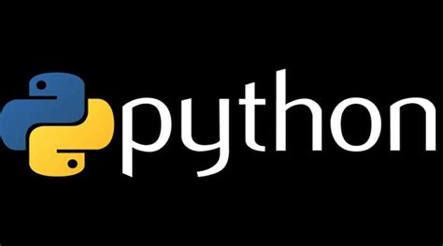
There are two languages that you can use to script in:
Bash - that’s the language that has the cmds that you always run in Linux
Python - more common among programmers
Versatile in the fact that you can import modules
Notes:
We will be going over both languages in the tutorial. Most of the stuff will be about bash just because if you script in Python, you will end up importing commands from bash to Python.

Slide 3
First… Let’s make our script file
In terminal, type in:
[you favorite editor] [filename].sh/.py
The “.sh/.py” will allow your computer to recognize the contents of your file as code
Now for the “shebang”
Allows computer to identify what language you coded in
If Bash: #!/bin/bash or #!/bin/sh
If Python: #!/usr/bin/env python3
Notes:
Shebang in bash should look turquoise. I didn't color it in for this slid bc you wouldn’t see it :(

Slide 4
Making the Programs Run
Bash: type commands into file like you would in the terminal
Yay! No extra work for you!
Python: import your Bash commands
import os
Execute Bash commands
os.system(‘[cmd]’)
Notes:
Type commands below the shebang line

Slide 5
Variables and Arrays
Both Bash and Python initiate vars in the same way: [var]=[val]
Bash: have to put $ in front of var name to call var
Python: call var by just typing name
*Tip: Use vars and arrays only to represent strings*
Concepts of array use same, different ways of use
Bash: arr=(item1 item2)
-items separated by spaces
Python: arr=[item1, item2]
Separated by commas
To call element of array by index: arr[index]
Call array: arr
Add $ if Bash
*Tip: arrays are useful in for loops*
Notes:
Vars as nums won’t be really useful for scripting
We aren’t going over math operations in this tutorial
Explain indexes if necessary

Slide 6
If Statements
Bash:
if [condition]
then
[cmds]
else
[cmds]
fi
Condition is a cmd
If there is output w/ no error, do stuff nested in “then” section
Python:
if (condition):
[cmds]
else:
[cmds]
Conditions is a Boolean expression
I.e. item1 == item2

Slide 7

For Loops (this is where the array sauce is)
Bash:
for i in $[arr]:
do
[cmds]
done
Python:
for i in [arr]:
[cmds]
Notes:
Yeah ik stale meme

